Slide 1
Lecture 10
Understanding Harmony in the Self

Slide 2


Slide 3
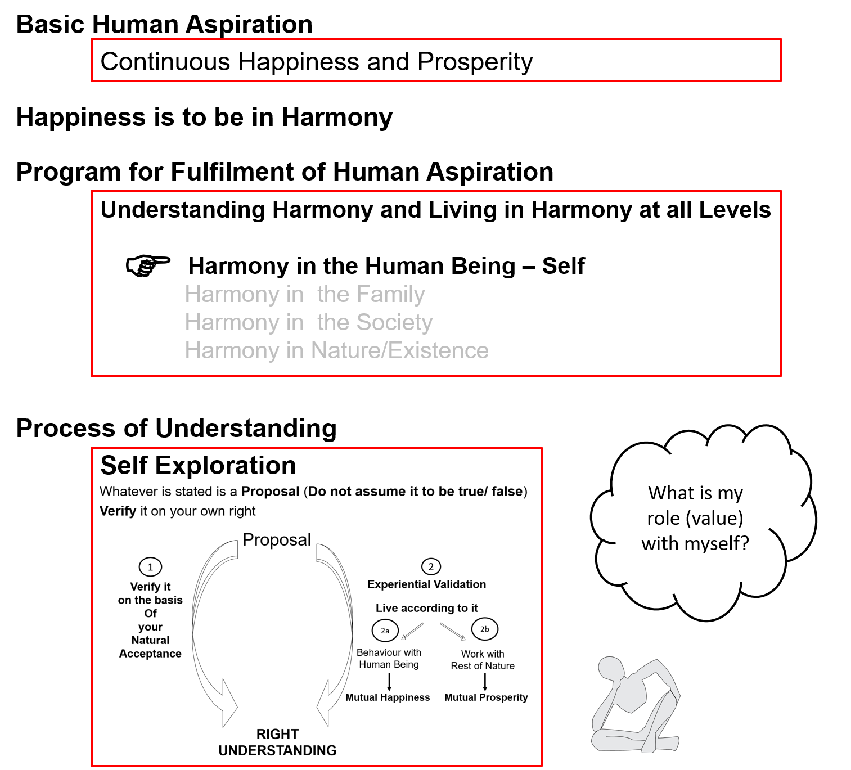

Slide 4
Human Being Ekkuo | Self eSa | Body “kjhj
Need vko';drk | Happiness (e.g. Respect) lq[k ¼tSls lEeku½ | Physical Facility (e.g. Food) lqfo/kk ¼tSls Hkkstu½
In Time dky esa | Continuous fujUrj | Temporary lkef;d
In Quantity ek=k esa | Qualitative (is Feeling) xq.kkRed ¼Hkko gS½ | Quantitative (Required in Limited Quantity) Ekk=kRed ¼lhfer ek=k esa½
Fulfilled By iwfrZ ds fy, | Right Understanding & Right Feeling lgh le>] lgh Hkko | Physio-chemical Things HkkSfrd&jklk;fud oLrq
Activity fØ;k | Desire, Thought, Expectation… bPNk] fopkj] vk”kk--- | Eating, Walking… [kkuk] pyuk---
In Time dky esa | Continuous fujUrj | Temporary lkef;d
Response | Knowing, Assuming, Recognising, Fulfilling tkuuk] ekuuk] igpkuuk] fuokZg djuk | Recognising, Fulfilling igpkuuk] fuokZg djuk
 | Consciousness pSrU; | Material tM+
Co-existence
lgvfLrRo

Slide 5
Self Body
Consciousness |  | Material
I am |  | My body is
I want to live |  | My body is used as an instrument
I want to live with continuous happiness |  | Physical facility is required for nurturing, protection and right utilization of the body
To understand and to live in harmony at all levels of being (from self to entire existence) is my program of action for continuous happiness |  | Production, protection and right utilization of physical facility is a part of my program (<1/4th)
I am the: Seer, Doer, Enjoyer (Experiencer) nz’Vk] drkZ] HkksDrk |  | I use the body as an instrument for fulfillment of my program
INFORMATION
Instruction
Sensation
The Self is
central to human existence
The Body is
an instrument of the Self

Slide 6

Activities of Self eSa dh fdz;k,a
 | Ability
1.
2.
3. | Desire bPNk
4. | Thought fopkj
5. | Expectation vk'kk
Activity fØz;k
Imaging fp=.k
Analysing-Comparing fo'ys"k.k&rqyu
Selecting-Tasting p;u&vkLoknu
Self eSa
Imagination
dYiuk”khyrk
Information
Body 'kjhj
Behaviour O;ogkj
Work dk;Z

Slide 7
Activities of Self eSa dh fdz;k,a
 | Power “kfDr
1.
2.
3. | Desire bPNk
4. | Thought fopkj
5. | Expectation vk'kk
Activity fØz;k
Imaging fp=.k
Analysing-Comparing fo'ys"k.k&rqyu
Selecting-Tasting p;u&vkLoknu
Meaning
What I want to BE within
How to go about it How to fulfil the desire or expectation
What I want to GET from outside What I want to DO outside…
Self eSa
Information
Body 'kjhj
Imagination
dYiuk”khyrk
Note: We explore these activities in detail in UHV-III

Slide 8
Sources of Motivation for our Imagination and its Implications
 | Ability
1.
2.
3. | Desire bPNk
4. | Thought fopkj
5. | Expectation vk'kk
Activity fØz;k
Imaging fp=.k
Analysing-Comparing fo'ys"k.k&rqyu
Selecting-Tasting p;u&vkLoknu
Self verification on the basis of Natural Acceptance
lgt Loh—fr ds vk/kkj ij tkap dj
Self eSa
3
Preconditioning
ekU;rk
Content of Imagination
dYiuk”khyrk
dh oLrq
Self-organised
Lora=rk √
1
Enslavement
ijra=rk X
Information
Body 'kjhj
2
Sensation
laosnuk
Behaviour O;ogkj
Work dk;Z
Enslavement ijra=rk X

Slide 9
Source of Motivations for our Desires - Its Implications
 | Power “kfDr
1.
2.
3. | Desire bPNk
4. | Thought fopkj
5. | Expectation vk'kk
Activity fØz;k
Imaging fp=.k
Analysing-Comparing fo'ys"k.k&rqyu
Selecting-Tasting p;u&vkLoknu
Self verification on the basis of Natural Acceptance
lgt Loh—fr ds vk/kkj ij tkap dj
Self eSa
3
Preconditioning
ekU;rk
Self-organised
Lora=rk √
1
Enslavement
ijra=rk X
Imagination
dYiuk”khyrk
Information
Body 'kjhj
2
Sensation
laosnuk
Behaviour O;ogkj
Work dk;Z
Enslavement ijra=rk X

Slide 10
Preconditioning, Sensation and Natural Acceptance
Preconditioning: Assuming without knowing. Depends on something or someone outside, keeps changing. Not sure if it leads to harmony or if it leads to contradiction
Sensation: Happiness from favourable sensation of Sound, Touch, Form, Taste, Smell through body
Happiness from indulgence
tasty-necessary → tasty-unnecessary → tasteless-unnecessary → intolerable
Natural Acceptance: Purpose or what to be, what to do as a human being. Leads to harmony (happiness) within, continuity is desirable, possible
  For Relationship [for mutual fulfillment, complimentarity, not for opposition]
  For Harmony [for mutual enrichment, not for exploitation- being in harmony within, and harmony with outside]
  For Co-existence [for co-existence, not for conflict]

Slide 11
Content of Imagination in the Self
Natural Acceptance
Is it like this?
D = Continuous Happiness & Prosperity
D1 D2 D3 …..Dn
T₁₁, T_{12 ….}T_{1n} T₂₁, T₂₂,…T_{2n} T₃₁, T₃₂,..T_{3n} T_{n1}, T_{n2},..T_{nn}
E₁₁₁, E₁₁₂ ,.. E_{1n} E₂₁, E₂₂,.. E_{2n}
Or is it like this?
Natural Acceptance
Preconditioning
Sensation
D = ?
D1.. Dn = Consumption,
profit, name, fame…
sensual pleasure …
knowledge,…
D1 D2 D3 …Dn
T₁₁, T_{12,….}T_{1n} T₂₁, T₂₂, …T_{2n} T₃₁, T₃₂,…T_{3n} T_{n1}, T_{n2},…T_{nn}
E₁₁₁, E₁₁₂ ,.. E_{1n} E₂₁, E₂₂,.. E_{2n}

Slide 12
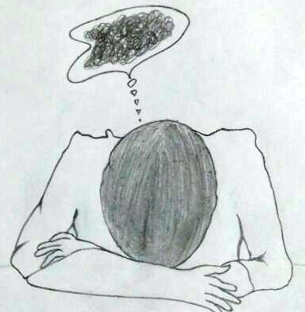
State of Imagination – Random and Disorganised
If the imagination is random and disorganised
It indicates a state of confusion
Many of these imaginations may be
contrary to each other and contrary to the natural acceptance
This contradiction in desires, in thoughts, in expectations, this contradiction between desires and thoughts, this contradiction between desire-thought-expectation and the natural acceptance, all these contradictions result in unhappiness
If we observe carefully, we realize that we have accumulated a lot of desires, which are resulting in numerous thoughts and expectations
Harmony in the Self is realised when there are no contradictions in the imagination and all imagination is in accordance with natural acceptance

Slide 13

State of Imagination – Random and Disorganised
 | Force / Power cy@“kfDr | Activity fØz;k
1. |  | Realization vuqHko
2. |  | Understanding cks/k
3. | Desire bPNk | Imaging fp=.k
4. | Thought fopkj | Analysing fo'ys"k.k
5. | Expectation vk'kk | Selecting/Tasting p;u@vkLoknu
Natural Acceptance
INTENTION
3
Preconditioning
ekU;rk
1
COMPETENCE
What You Are
Information
Body 'kjhj
2
Sensation
Lakosnuk
Behaviour O;ogkj
Work dk;Z

Slide 14
Harmony in Self = D, T, E in accordance with Natural Acceptance
 | Force / Power cy@“kfDr | Activity fØz;k
1. |  | Realization vuqHko
2. |  | Understanding cks/k
3. | Desire bPNk | Imaging fp=.k
4. | Thought fopkj | Analysing fo'ys"k.k
5. | Expectation vk'kk | Selecting/Tasting p;u@vkLoknu
Right Understanding to be ensured in the Self
Natural Acceptance
INTENTION
Guided
Content of imagination
COMPETENCE
What You Are
Guided by
Right Understanding
Information
Body 'kjhj
Behaviour O;ogkj
Work dk;Z
Happiness = To be in a state of Harmony
Lkq[k ¾ laxhr esa] O;oLFkk esa thuk

Slide 15
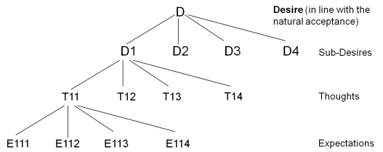
State of Imagination
If the imagination is random and disorganised
It indicates a state of confusion
Many of these imaginations may be
contrary to each other and contrary to the natural acceptance
Contradiction → unhappiness
Harmony in the Self is realised when there are no contradictions in the imagination and all imagination is in accordance with natural acceptance. Harmony → happiness

Slide 16
Source of Motivations for our Desires - Its Implications
 | Power “kfDr
1.
2.
3. | Desire bPNk
4. | Thought fopkj
5. | Expectation vk'kk
Activity fØz;k
Imaging fp=.k
Analysing-Comparing fo'ys"k.k&rqyu
Selecting-Tasting p;u&vkLoknu
What I Really Want to Be
My Natural Acceptance
My Intention
Preconditioning
Self-exploration
Contradiction
Unhappiness
Harmony
Happiness
Dialogue
Harmony
What I am
My Imagination
My Competence
Harmony?
Contradiction?
Sensation

Slide 17
Happiness = To Be in Harmony – In the Self
What I Really Want to Be
My Natural Acceptance
My Intention
Always
Relationship
These are in Contradiction
Unhappiness
These are in Harmony
Happiness
Self Exploration
Dialogue
What I am
My Desire, Thought, Expectation…
My Competence
Sometimes
Opposition
Sometimes
Relationship

Slide 18
State of Imagination – Random and Disorganised
If the imagination is random and disorganised
It indicates a state of confusion
Many of these imaginations may be
contrary to each other and contrary to the natural acceptance
This contradiction in desires, in thoughts, in expectations, this contradiction between desires and thoughts, this contradiction between desire-thought-expectation and the natural acceptance, all these contradictions result in unhappiness
If we observe carefully, we realize that we have accumulated a lot of desires, which are resulting in numerous thoughts and expectations
Harmony in the Self is realised when there are no contradictions in the imagination and all imagination is in accordance with natural acceptance

Slide 19
State of Imagination – Consistent and Organized
D
Desire (in line with the natural acceptance)
D1
D2
D3
D4
Sub-Desires
T11
T12
T13
T14
Thoughts
E111
E112
E113
E114
Expectations

Slide 21
Sum Up
The Self is a unit of consciousness. It consists of various activities which are going on continuously
  The activities of desire, thought and expectation are together called imagination
  We can begin to observe the Self by becoming aware of our
    imagination and
    natural acceptance
  Behaviour and work are expressions of imagination
Imagination may be motivated by preconditioning or sensation or natural acceptance
  When imagination is fully motivated by natural acceptance, the Self is in harmony; and therefore in a state of continuous happiness. This is the state of self-organization (स्वतंत्रता). In this state, the conduct is definite and human
  When the imagination is motivated by preconditioning or sensation, the Self may be in harmony or disharmony/contradiction; and thus in a state of happiness or unhappiness. The state of the self is largely decided by external influence. This is a state of enslavement (परतंत्रता). In this state, the conduct is indefinite (it may be human or inhuman)

Slide 22
Self Reflection

Slide 23
Some Details of
The Self

Slide 24
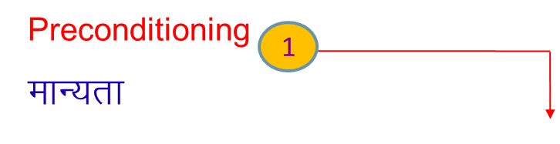
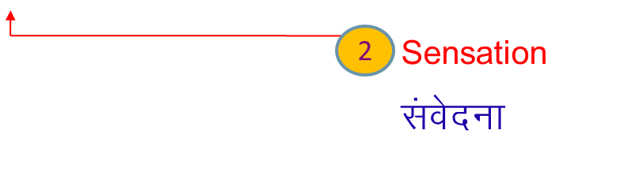
Deluded Self: Imagination on basis of Sensation & Preconditioning
  Self verification on the basis of Natural Acceptance
  lgt Loh—fr ds vkËkkj ij tkap dj
 | Power “kfDr | Dynamic Activity xfr fØz;k | State Activity fLFkfr fØz;k
1. |  | Authentication Áek.k | Realization vuqHko
2. |  | Determination ladYi | Understanding cks/k
3. | Desire bPNk | Imaging fp=.k | Contemplation fparu
4. | Thought fopkj | Analysing fo'ys"k.k | Comparing rqyu | Unguided Senses, Health, Profit
5. | Expectation vk'kk | Selecting p;u | Tasting vkLoknu | Unguided Sensation
B1
3
Self
eSa
B2
Body 'kjhj
Behaviour O;ogkj
Human ekuo
Work dk;Z
Rest of Nature
euq";srj iz—fr
Other nwljk

Slide 25
Pure Self: Imagination on basis of Realisation, Understanding & Contemplation
Space “kwU;
 | Power “kfDr | Dynamic Activity xfr fØz;k | State Activity fLFkfr fØz;k
1. |  | Authentication Áek.k | Realization vuqHko | Co-existence lg&vfLrRo
2. |  | Determination ladYi | Understanding cks/k | Harmony in Nature O;oLFkk
3. | Desire bPNk | Imaging fp=.k | Contemplation fparu | Participation in Larger Order, Relationship O;oLFkk esa Hkkxhnkjh
4. | Thought fopkj | Analysing fo'ys"k.k | Comparing rqyu | Co-existence, Harmony, Justice Guided Senses, Health, Profit
5. | Expectation vk'kk | Selecting p;u | Tasting vkLoknu | Goal, Value Guided Sensation
B1
Self
eSa
B2
Body 'kjhj
Behaviour O;ogkj
Human ekuo
Work dk;Z
Rest of Nature
euq";srj iz—fr
Participation Òkxhnkjh
in larger Order O;oLFkk esa
Other nwljk

Slide 26
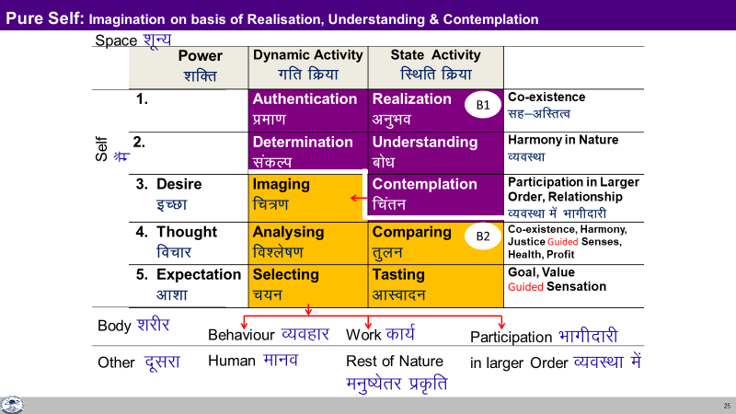
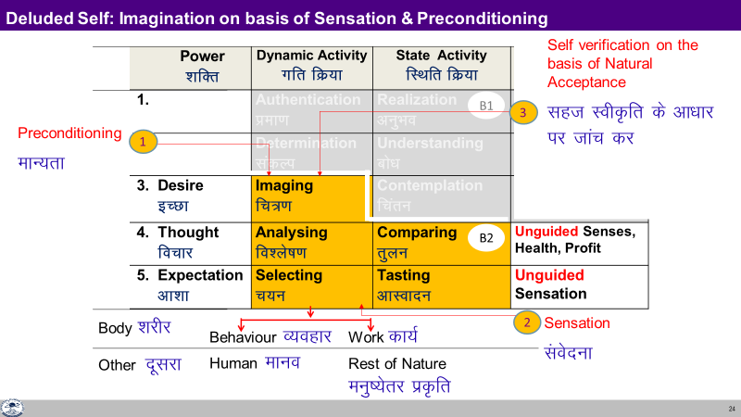
Development of the Self

Slide 27
Sanskar
Sanskar =
Acceptances derived out of ∑ [ Desire + Thought + Expectation ]
from all time
Presently, it is likely to be a mixture of:
  Understanding of the human reality, of the universal, invariant existential laws / principles
  Conclusions drawn from life events / experiences, which may or may not be in line with the existential laws / principles
“What I Am” is largely our sanskar
Our perspective is a part of our sanskar
Our tendencies, habits, likes-dislikes are also a part of our sanskar

Slide 28
Updating of Sanskar
Sanskar =
Acceptances derived out of ∑ [ Desire + Thought + Expectation ]
from all time
Presently, it is likely to be a mixture of :
  Understanding of the human reality, of the universal, invariant existential laws / principles
  Conclusions drawn from life events / experiences, which may or may not be in line with the existential laws / principles
Sanskar is updated over time:
Sanskar (t+1) = Sanskar (t) + Environment (t) + Self-exploration (t)
As we self-explore, verify and understand, our sanskar gets updated
A conducive environment is helpful

Slide 29
Program of Action (Individual)
To understand harmony and to live in harmony
– at all levels of being (individual, family, society, nature/existence)
Self-exploration – Verify the proposals on your own right → right understanding (of harmony) → feeling and thought of harmony → harmonious behaviour, work and participation in larger order
Self-awareness – Be aware of your desire, thought and expectation – every moment
Self-evaluation – Evaluate your desire, thought and expectation
    – on the basis of your Natural Acceptance
What I Really Want to Be
My Natural Acceptance
My Intention
Discover
Guide
What I am
My Desire, Thought, Expectation…
My Competence
Purify

Slide 30
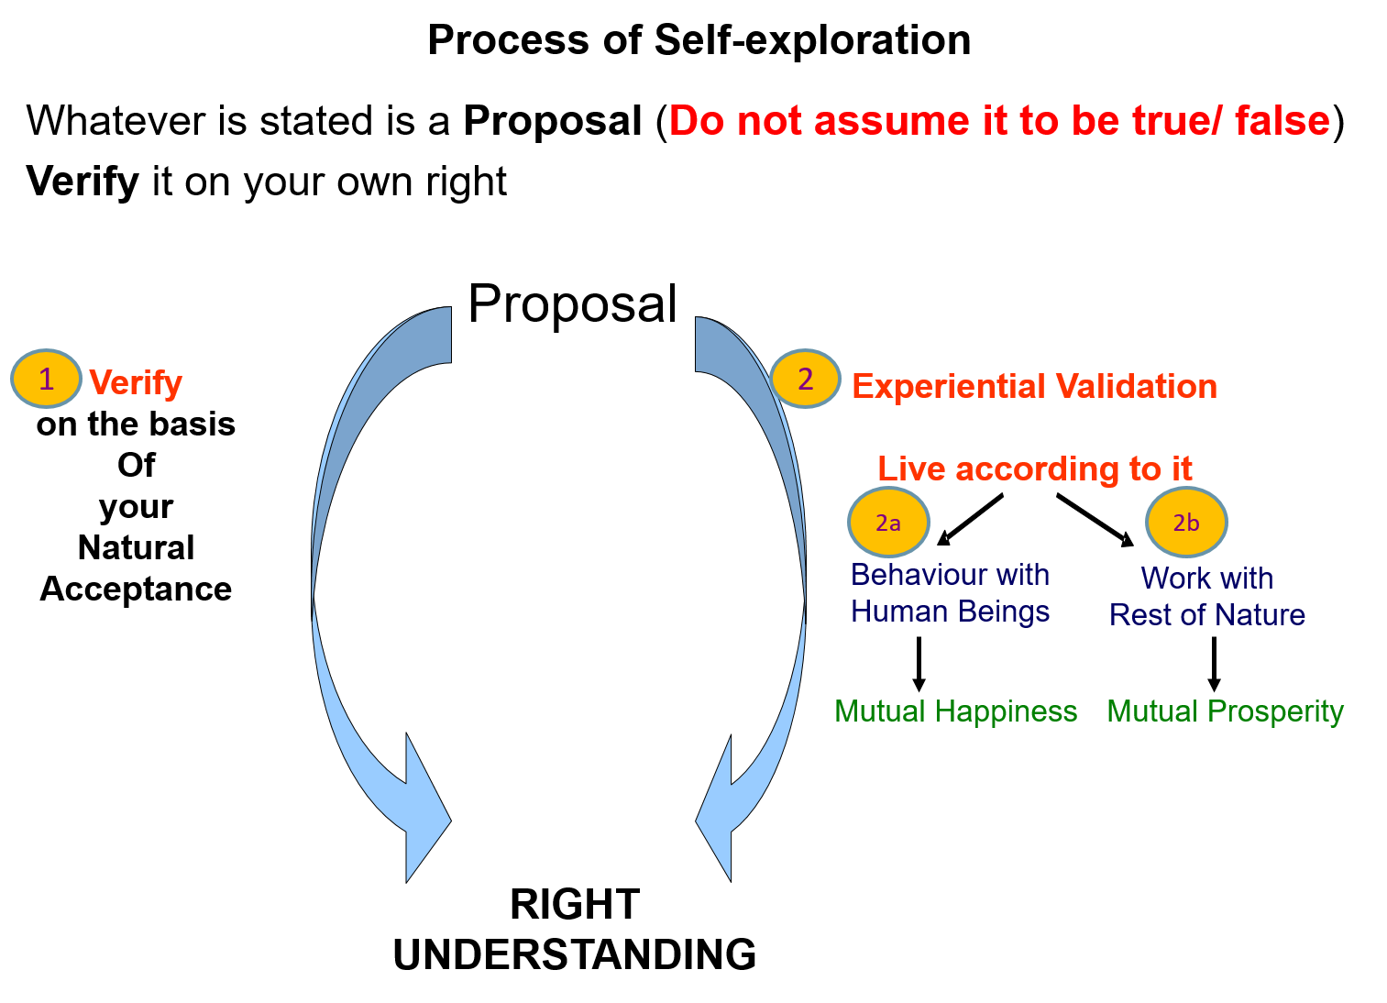
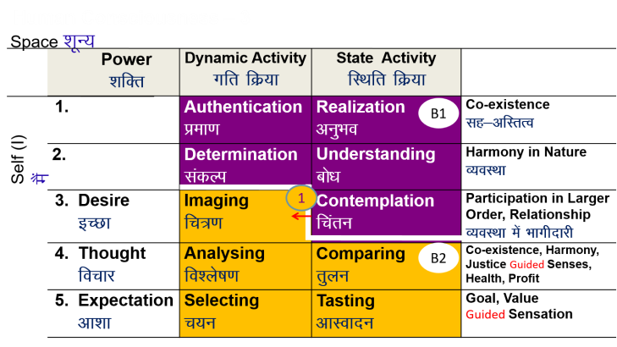
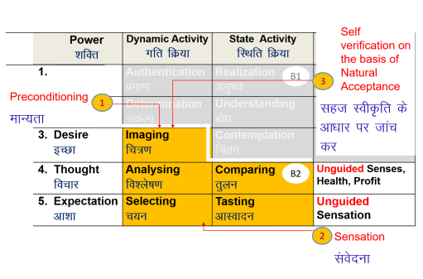
Program of Action (Individual) – 1: Develop Right Understanding
Self-exploration
Verify the proposals
(on your own right)
    Right understanding of harmony at all levels
    Feeling and thought
    of harmony
    Harmonious behaviour, work and participation in larger order

Slide 31
Program of Action (Individual) – 2: Purification of Sanskar
Self-awareness – Be aware of your desire, thought and expectation – every moment
Self-evaluation – Evaluate your desire, thought and expectation
    – on the basis of your Natural Acceptance
Sanskar =
Acceptances derived out of
∑ [Desire + Thought + Expectation]
from all time
Sanskar (t+1) =
Sanskar (t) +
Environment (t) +
Self-exploration (t)

Slide 32
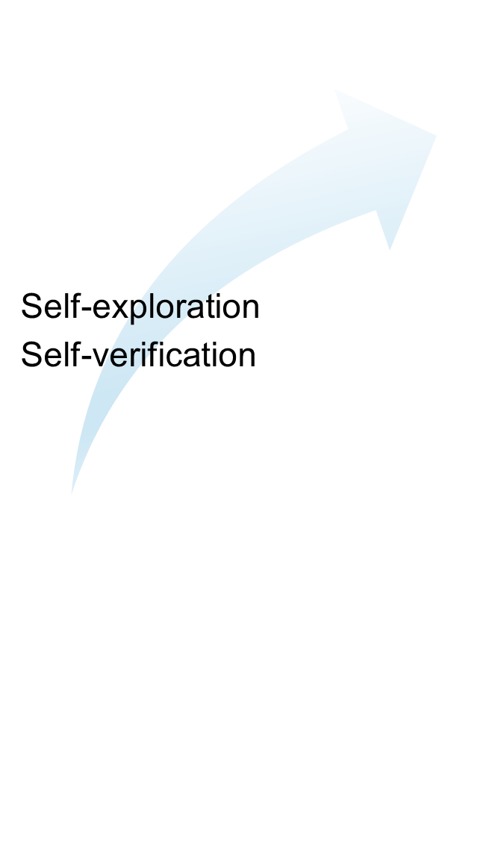

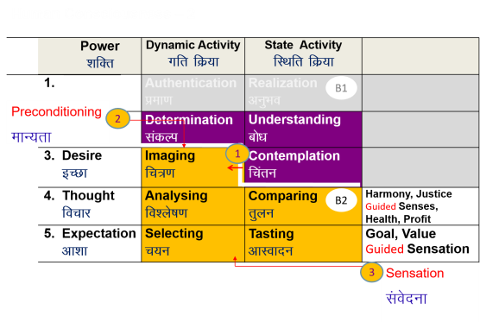
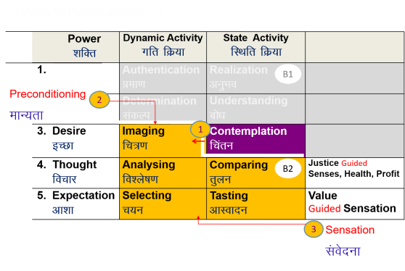

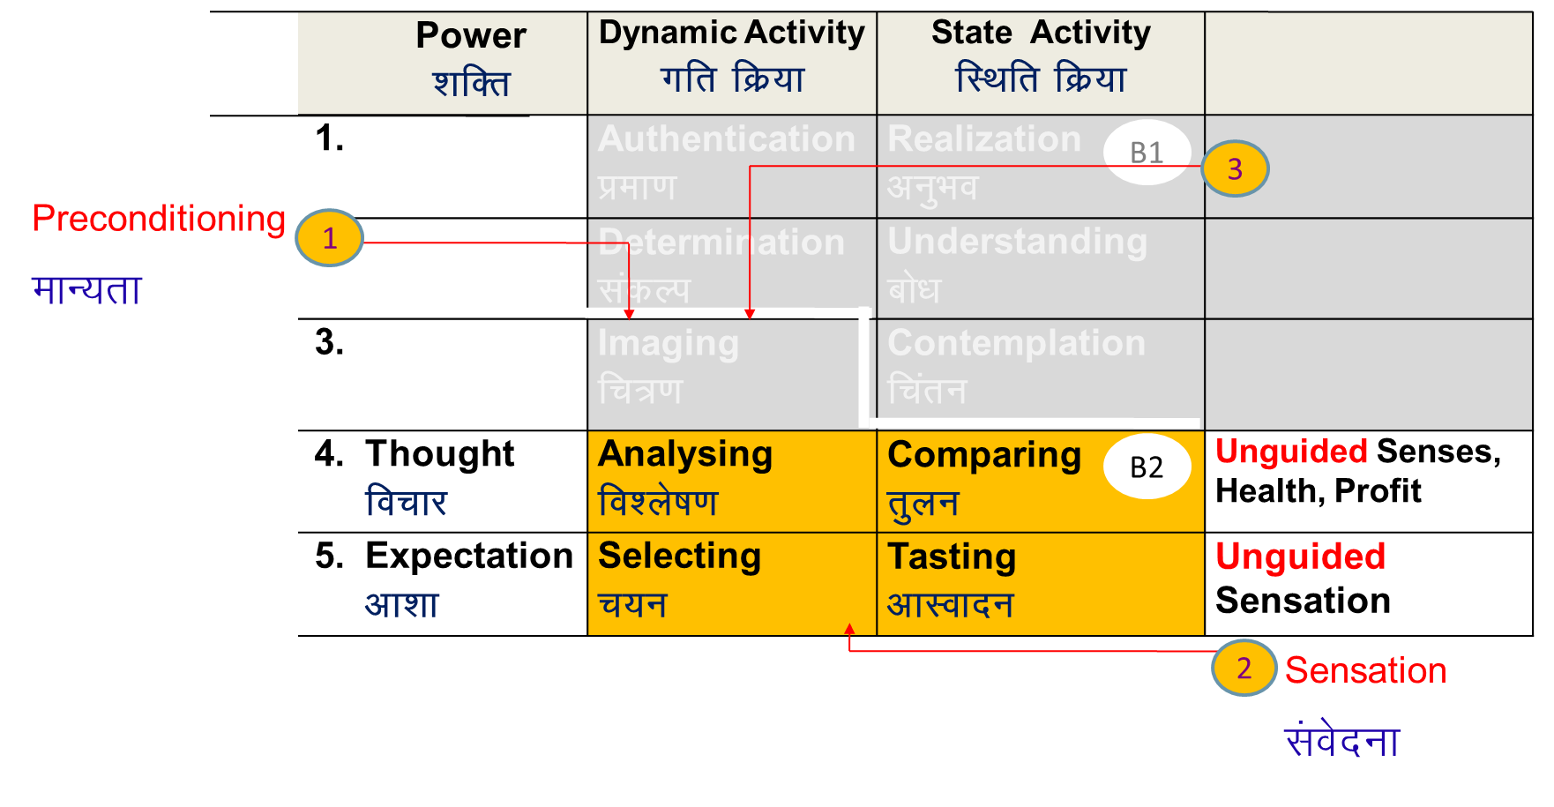
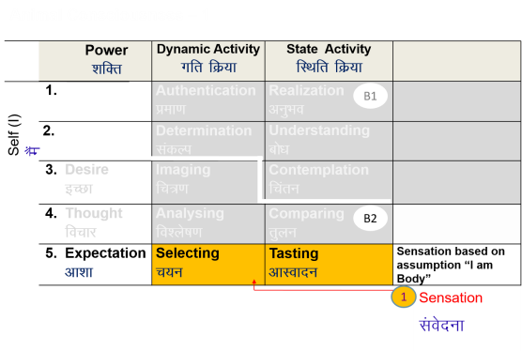
Self-evolution
Human Consciousness
Living on the basis of knowing
Happiness by being in harmony within and harmony in all aspects of being
Acceptance of relationship – from one to many, to all [HAPPINESS]
Identifying need, production, right utilisation of physical facility [PROSPERITY]
Participation in larger order, expanding harmony [SOCIETAL DEVELOPMENT]
Transformation / Development
Preparation for Transformation
Living on the basis of assuming (without knowing)
Happiness from outside (through feeling from the other, sensual pleasure and physical facility)
Domination and opposition in relationship [UNHAPPINESS]
Exploitation and indulgence [DEPRIVATION]
Exploitation in larger order, increasing disorder [DEGRADING SOCIETY]

Slide 33
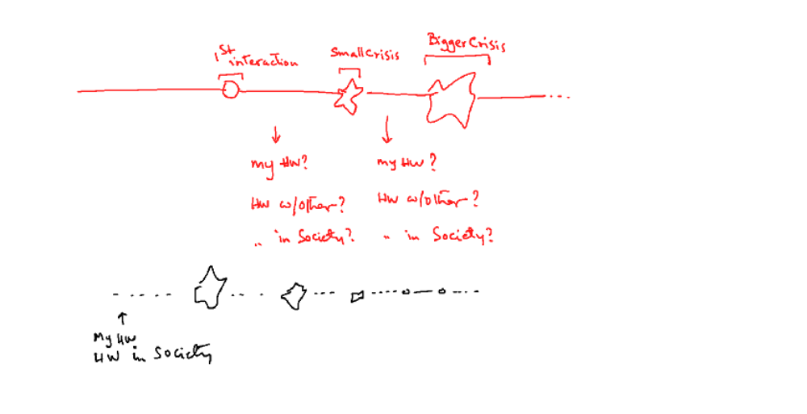

Slide 34

Self-evolution

Slide 35
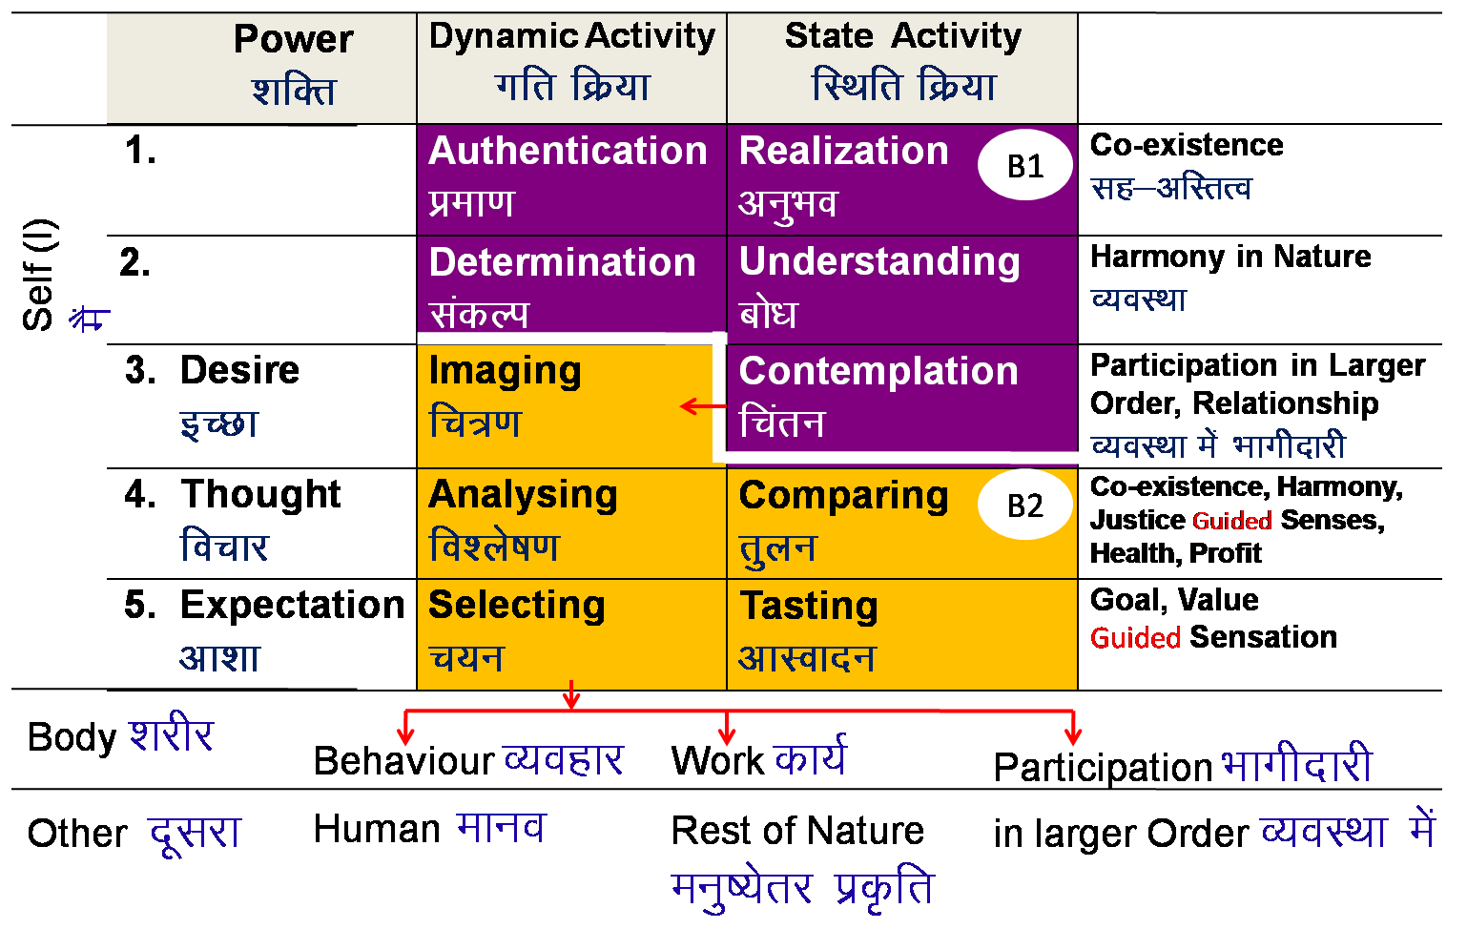
Realisation of Co-existence & it’s expression – Universal Human Order
REALISATION WITHIN
Mutual Happiness
mHk; lq[k
Mutual Prosperity
mHk; le`f)
Fulfillment of Human Goal
Ekkuo y{; dh iwfrZ
Human Tradition
ekuoh; ijaijk
Undivided Human Society
v[k.M ekuoh; lekt
EXPRESSION OUTSIDE
Universal Human Order
lkoZHkkSe ekuoh; O;oLFkk

Slide 36
Key Points
Understanding Harmony in the Self

Slide 38
Human Being Ekkuo | Self eSa | Body “kjhj
Need vko';drk | Happiness (e.g. Respect) lq[k ¼tSls lEeku½ | Physical Facility (e.g. Food) lqfo/kk ¼tSls Hkkstu½
In Time dky esa | Continuous fujUrj | Temporary lkef;d
In Quantity ek=k esa | Qualitative (is Feeling) xq.kkRed ¼Hkko gS½ | Quantitative (Required in Limited Quantity) Ekk=kRed ¼lhfer ek=k esa½
Fulfilled By iwfrZ ds fy, | Right Understanding & Right Feeling lgh le>] lgh Hkko | Physio-chemical Things HkkSfrd&jklk;fud oLrq
Activity fØ;k | Desire, Thought, Expectation… bPNk] fopkj] vk”kk--- | Eating, Walking… [kkuk] pyuk---
In Time dky esa | Continuous fujUrj | Temporary lkef;d
Response | Knowing, Assuming, Recognising, Fulfilling tkuuk] ekuuk] igpkuuk] fuokZg djuk | Recognising, Fulfilling igpkuuk] fuokZg djuk
 | Consciousness pSrU; | Material tM+
Co-existence
lgvfLrRo

Slide 39
Activities of Self eSa dh fdz;k,a
 | Ability
1.
2.
3. | Desire bPNk
4. | Thought fopkj
5. | Expectation vk'kk
Activity fØz;k
Imaging fp=.k
Analysing-Comparing fo'ys"k.k&rqyu
Selecting-Tasting p;u&vkLoknu
Self eSa
Imagination
dYiuk”khyrk
Information
Body 'kjhj
Behaviour O;ogkj
Work dk;Z

Slide 40
Activities of Self eSa dh fdz;k,a
 | Power “kfDr
1.
2.
3. | Desire bPNk
4. | Thought fopkj
5. | Expectation vk'kk
Activity fØz;k
Imaging fp=.k
Analysing-Comparing fo'ys"k.k&rqyu
Selecting-Tasting p;u&vkLoknu
Meaning
What I want to be My feeling within
How to go about it How to ensure fulfillment of the feeling (its details)
What I have to do outside for expression of the feeling
Self eSa
Information
Body 'kjhj
Note: We explore these activities in detail in UHV-III

Slide 41
Sources of Motivation for our Imagination and its Implications
 | Ability
1.
2.
3. | Desire bPNk
4. | Thought fopkj
5. | Expectation vk'kk
Activity fØz;k
Imaging fp=.k
Analysing-Comparing fo'ys"k.k&rqyu
Selecting-Tasting p;u&vkLoknu
Self verification on the basis of Natural Acceptance
lgt Loh—fr ds vk/kkj ij tkap dj
Self eSa
3
Preconditioning
ekU;rk
Content of Imagination
dYiuk”khyrk
dh oLrq
Self-organised
Lora=rk √
1
Enslavement
ijra=rk X
Information
Body 'kjhj
2
Sensation
laosnuk
Behaviour O;ogkj
Work dk;Z
Enslavement ijra=rk X

Slide 42
State of Imagination – Random and Disorganised
 | Force / Power cy@“kfDr | Activity fØz;k
1. |  | Realization vuqHko
2. |  | Understanding cks/k
3. | Desire bPNk | Imaging fp=.k
4. | Thought fopkj | Analysing fo'ys"k.k
5. | Expectation vk'kk | Selecting/Tasting p;u@vkLoknu
Natural Acceptance
INTENTION
3
Preconditioning
ekU;rk
1
COMPETENCE
What You Are
Information
Body 'kjhj
2
Sensation
Lakosnuk
Behaviour O;ogkj
Work dk;Z

Slide 43
Harmony in Self = D, T, E in accordance with Natural Acceptance
 | Force / Power cy@“kfDr | Activity fØz;k
1. |  | Realization vuqHko
2. |  | Understanding cks/k
3. | Desire bPNk | Imaging fp=.k
4. | Thought fopkj | Analysing fo'ys"k.k
5. | Expectation vk'kk | Selecting/Tasting p;u@vkLoknu
Right Understanding to be ensured in the Self
Natural Acceptance
INTENTION
Guided
Content of imagination
COMPETENCE
What You Are
Guided by
Right Understanding
Information
Body 'kjhj
Behaviour O;ogkj
Work dk;Z
Happiness = To be in a state of Harmony
Lkq[k ¾ laxhr esa] O;oLFkk esa thuk

Slide 44
Sum Up
The Self is a unit of consciousness. It consists of various activities which are going on continuously
  The activities of desire, thought and expectation are together called imagination
  We can begin to observe the Self by becoming aware of our
    imagination and
    natural acceptance
  Behaviour and work are external expressions of imagination
Imagination may be motivated by preconditioning or sensation or natural acceptance
  When imagination is fully motivated by natural acceptance, the Self is in harmony; and therefore in a state of continuous happiness. This is the state of self-organization (स्वतंत्रता). In this state, the conduct is definite and human
  When the imagination is motivated by preconditioning or sensation, the Self may be in harmony or disharmony/contradiction; and thus in a state of happiness or unhappiness. This is a state of enslavement (परतंत्रता). In this state, the conduct is indefinite (it may be human or inhuman)

Slide 45
FAQs for Lecture 10
Understanding Harmony in the Self

Slide 46
Question(s): What is Self Response
Is Self the same as the mind or the soul?
Isn’t what is being said here the same as spirituality?
The mind is a part of the Self. The activity of imagination which includes activities of desire, thought and expectation if referred to as mind. Soul has been used in different ways, sometime it is used to represent the highest activity of the self while in many cases it is used to mean self as a whole.
We are trying to work for a system of education that makes us human. So, we are talking about humanness- what is being human.
Because human being is coexistence of self (consciousness) and body (material), hence, we have to understand the laws of material as well as the laws of consciousness. This is what we are trying to do.

Slide 47
Word
Meaning
(a description of some part of the reality)
Reality

Slide 48
Question(s): Activities of the Self Response
I do think sometimes but not all the time. Like when I am asleep, I do not think. So, why do we say activities of Self are continuous?
Most of the time, we are not able to remember what is going on in our imagination. Is there some practice, like meditation, to become aware of it?
Do you dream while sleeping? Does dream include thinking? Now,, try to be aware of your imagination when you are awake, then slowly you can be aware of your imagination even when you are asleep, then you will be able to verify whether you are thinking while sleeping or not.
One simple way to be aware of your self, be aware of the imagination going on in the self at this moment of time. If you are aware, it will be there in your remembrance. When you pay attention to your imagination, you are able to see it, because you already have the potential to see, you only have to exercise this potential ,

Slide 49
We all have the capacity to pay attention, to observe… to understand
You are already paying attention… to whatever you consider important
So, the main question is not “how to pay attention”, rather it is “what to pay attention to”
(object of attention)
One only has to see, to decide that:
I am important, Self is important
My imagination is important
Then I will pay attention to the Self and my imagination

Slide 50
Science of material
- You can look at it outside, you may not be
Science of consciousness
You are part of it, you want to and do get transformed

Slide 51
Question(s): Activities of the Self Response
What is the need to see these activities separately? How can we differentiate between desire and thought and expectation? It all seems to be one thing
If you do not observe things with fineness, everything seems to one gross thing. However, when you look at it with subtleness, you see that it is composed of many things. Like that, imagination is composed of three different levels of activities of the self- desire, thought and expectation. As explained, desire relates to our purpose, what we want to be, our feelings, while thought is working out the details of how to fulfill this purpose and expectation is what I need to do with the world outside. Desire is at the base of thought and expectation, so, if we have to evaluate our imagination and set it right, it has to be done at the level of desire, the feeling; and this desire, this feeling can be easily verified with our natural acceptance.

Slide 52
Activities of Self eSa dh fdz;k,a
 | Power “kfDr
1.
2.
3. | Desire bPNk
4. | Thought fopkj
5. | Expectation vk'kk
Activity fØz;k
Imaging fp=.k
Analysing-Comparing fo'ys"k.k&rqyu
Selecting-Tasting p;u&vkLoknu
Meaning
What I want to be My feeling within
How to go about it How to ensure fulfillment of the feeling (its details)
What I have to do outside for expression of the feeling
Self eSa
Information
Body 'kjhj
Imagination
dYiuk”khyrk
Note: We explore these activities in detail in UHV-III

Slide 53
Activities of Self eSa dh fdz;k,a
 | Power “kfDr
1.
2.
3. | Desire bPNk
4. | Thought fopkj
5. | Expectation vk'kk
Activity fØz;k
Imaging fp=.k
Analysing-Comparing fo'ys"k.k&rqyu
Selecting-Tasting p;u&vkLoknu
Meaning
What I want to be My feeling within
How to go about it How to ensure fulfillment of the feeling (its details)
What I have to do outside for expression of the feeling
Self eSa
Information
Body 'kjhj
Imagination
dYiuk”khyrk
Note: We explore these activities in detail in UHV-III

Slide 54
Pure Self: Imagination on basis of Realisation, Understanding & Contemplation
Space “kwU;
 | Power “kfDr | Dynamic Activity xfr fØz;k | State Activity fLFkfr fØz;k
1. |  | Authentication Áek.k | Realization vuqHko | Co-existence lg&vfLrRo
2. |  | Determination ladYi | Understanding cks/k | Harmony in Nature O;oLFkk
3. | Desire bPNk | Imaging fp=.k | Contemplation fparu | Participation in Larger Order, Relationship O;oLFkk esa Hkkxhnkjh
4. | Thought fopkj | Analysing fo'ys"k.k | Comparing rqyu | Co-existence, Harmony, Justice Guided Senses, Health, Profit
5. | Expectation vk'kk | Selecting p;u | Tasting vkLoknu | Goal, Value Guided Sensation
B1
Self
eSa
B2
Body 'kjhj
Behaviour O;ogkj
Human ekuo
Work dk;Z
Rest of Nature
euq";srj iz—fr
Participation Òkxhnkjh
in larger Order O;oLFkk esa
Other nwljk

Slide 55
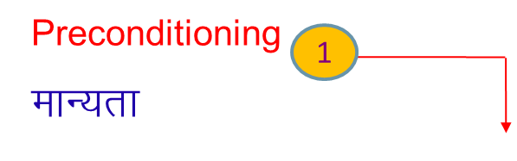
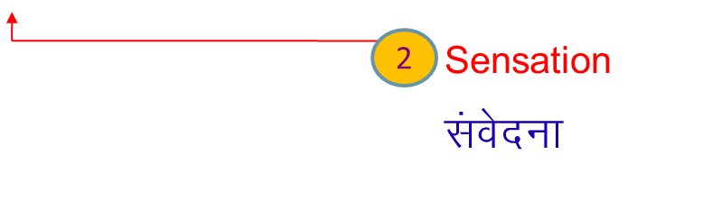
Deluded Self: Imagination on basis of Sensation & Preconditioning
  Self verification on the basis of Natural Acceptance
lgt Loh—fr ds vkËkkj ij tkap dj
 | Power “kfDr | Dynamic Activity xfr fØz;k | State Activity fLFkfr fØz;k
1. |  | Authentication Áek.k | Realization vuqHko
2. |  | Determination ladYi | Understanding cks/k
3. | Desire bPNk | Imaging fp=.k | Contemplation fparu
4. | Thought fopkj | Analysing fo'ys"k.k | Comparing rqyu | Unguided Senses, Health, Profit
5. | Expectation vk'kk | Selecting p;u | Tasting vkLoknu | Unguided Sensation
B1
3
Self
eSa
B2
Body 'kjhj
Behaviour O;ogkj
Human ekuo
Work dk;Z
Rest of Nature
euq";srj iz—fr
Other nwljk

Slide 56
Question(s): Activities of the Self Response
What is the difference between deciding and selecting? They seem same to me
What is in activity 1 & 2? Why is it kept blank?
Deciding is working out the details of how to fulfill the purpose, the desire; whereas selecting has to do with what to do at the level of world outside. For example, if I have feeling of respect, then this is my desire, now, when work out the details of how to express this feeling of respect, by giving blessing, touching feet, greeting with some gift etc., it is a thought ; when this greeting is to be done with a flower bouque, it is expectation.
We will talk about these higher activities in detail in later course UHV III; however, we will very briefly introduce the activities of realisation and understanding as 1 and 2 towards the end of the session.

Slide 57
Question(s): Activities of the Self Response
Isn’t desire and intention the same?
What is the meaning of competence? Is it the skill?
Intention has to do with the feeling which is in accordance with natural acceptance, hence is definite, while desire could any feeling, in accordance or against the natural acceptance, hence is definite. For example, intention will always be for feeling of respect while desire could be for feeling of respect or disrespect.
The word competence is used to represent what is our state at the level of imagination-what is our desire, thought and expectation, as that will decide our behaviour with world outside as well.
The more our imagination is in harmony, the more competent we are

Slide 58
State of Imagination – Random and Disorganised
 | Force / Power cy@“kfDr | Activity fØz;k
1. |  | Realization vuqHko
2. |  | Understanding cks/k
3. | Desire bPNk | Imaging fp=.k
4. | Thought fopkj | Analysing fo'ys"k.k
5. | Expectation vk'kk | Selecting/Tasting p;u@vkLoknu
Natural Acceptance
INTENTION
3
Preconditioning
ekU;rk
1
COMPETENCE
What You Are
Information
Body 'kjhj
2
Sensation
Lakosnuk
Behaviour O;ogkj
Work dk;Z

Slide 59
Question(s): Activities of the Self Response
Can you tell us something about the conscious, subconscious and super conscious mind
The sense in which these words are used in general is the following-
when we are aware of what is going on in the self, it is being conscious,
when we are not aware of what is going on in the self, it is being subconscious,
when we are operating with higher activities of the self, like realisation and understanding, it is called super conscious,
Unconscious – not aware of the world outside
Freud:
id selecting-tasting
Ego imagination based on preconditioning “I am separate from the other, in isolation”
Super ego superconscious

Slide 60
Question(s): Preconditioning Response
What is preconditioning? “resources are limited, Desires are unlimited” is that a preconditioning or reality?
(it implies that everyone is bound to be deprived!
Preconditioning is something which is prevailing in the society which we have accepted without verification or without knowing. We are dictated by the world outside. A preconditioning may or may not correspond to a reality.
As far as this particular preconditioning is concerned, it does not correspond to a reality because
Desires, if we understand properly, are definite i.e., continuity of happiness and prosperity and the amount of physical facility required for ensuring prosperity is limited and can be identified.
Availability of resources in nature and capacity to produce in human being is more than what is required.

Slide 61
Desires are definite
Resources are limited, but more than our needs
Therefore, everyone can be prosperous)
Need to study
Science of material (the world outside) – I am what I am, I don’t have to change
Science of consciousness (the world within) – I have to see myself… then I am motivated to develop, to transform to human consciousness

Slide 62
Question(s): Conditioning Response
Pavlov has a theory of conditioning. How does it apply to us?
If we identify ourselves as the body and therefore, if the self is influenced by the body then Pavlov theory of conditioning will hold good. However, if we can understand the self and body separately and the self has right understanding and right feeling, than self is in a self-organised state and it responds to any input from the body, and not react. Therefore, its response to the input from the body will depend upon what self finds appropriate for maintaining the health of the body rather than the conditioning which is tried to be created through the conditioning input.
Self can even articulate that some conditioning is being created and therefore, he will be out of conditioning.

Slide 63
Question(s): Motivation of Imagination Response
What exactly is natural acceptance? Is it same as right understanding?
How can I be sure that my imagination is motivated by my natural acceptance?
Natural acceptance is something which is part of our being. It is innate, invariant, and uncorrupted by the preconditioning for ex. we have natural acceptance for the feeling of relationship, feeling of nurturing the body. It is the answer that we get from our conscience or the inner voice or the pure observer which is innermost part of the self.
Right understanding is understanding the reality as it is, and this can be ensured through the process of self-exploration based on natural acceptance and experiential validation.
If my imagination is in accordance with my natural acceptance, then I am in state of harmony within, happiness within. If not, then I am in contradiction within, unhappiness within.

Slide 64
Question(s): Motivation of Imagination Response
The exercise on list of desires was interesting. Most of the motivation turned out to be from preconditioning and sensation. So now, I can understand the need for exploring into my natural acceptance and also to check my preconditionings. What exactly should I do for this? Any practice?
This has already been mentioned that we have to be aware of our own self every moment and it can have different steps
Being aware of the imagination going on in the self, particularly the desire, the feeling
Verifying whether this desire, this feeling is in naturally acceptable to me or not
Whether it leads to harmony or happiness within or otherwise
Verifying that the feeling of relationship, harmony and coexistence is naturally acceptable to me and not the feeling of opposition, disharmony and struggle.
To ensure that the desire, the feeling is in accordance with the feeling of relationship, harmony and coexistence,

Slide 65
Question(s): Harmony in the Self, Happiness Response
When I am reading something, I think of many other things... How can I focus on what I have to read?
Our attention keeps going to the things which we feel is important. So we have to decide what is important for me at this point of time.
If there are many things that are important, than I will have to set up a priority among them. If I am able to do that, than my attention will be focused on the thing which is assigned the highest priority.

Slide 66
Question(s): Harmony in the Self, Happiness Response
It is said that we have to get rid of desires to be happy. Isn’t that true?
We have to have the right desire and we have to have the continuity of this right desire. We have to get rid of the wrong desire and wrong feelings. Infact they are not the real desires, real feelings but we have assumed them to be our desire, our feeling because of the prevalent beliefs in the society. Therefore we should get rid of these wrong desires, wrong feelings.
In essence, to be happy we have to have the right desire, right feeling.
  Truth, Understanding relationship, harmony & co-existence
  Love, Feeling of acceptance of all, Feeling of co-existence, harmony, relationship
  Compassion, Thought… of how to fulfil my feeling of Love…

Slide 67
Question(s): Harmony in the Self, Happiness Response
Split personality, schizophrenia…
Split between NA and Imaginatoin
Presently as per science
Schizophrenia is characterized by avolition (motivation less state), hallucinations and illusions, dopamine and serotonin are two main neurotransmitter playing role. Has positive (elated) and negative phase (avolition),
Split personality is to do with disconnection with reality, just like inability to differentiate dream from reality.

Slide 68
Source of Motivations for our Desires - Its Implications
 | Power “kfDr
1.
2.
3. | Desire bPNk
4. | Thought fopkj
5. | Expectation vk'kk
Activity fØz;k
Imaging fp=.k
Analysing-Comparing fo'ys"k.k&rqyu
Selecting-Tasting p;u&vkLoknu
What I Really Want to Be
My Natural Acceptance
My Intention
Preconditioning
Self-exploration
Contradiction
Unhappiness
Harmony
Happiness
Dialogue
Harmony
What I am
My Imagination
My Competence & Incompetence
Harmony?
Contradiction?
Sensation

Slide 69
Question(s): Harmony in the Self, Happiness Response
What is the meaning of “development of the Self”?
Development of self would mean having right understanding i.e., understanding the harmony (relationship, harmony, coexistence) at all levels of our being and feeling of harmony at all levels of our being. This will ensure the state of harmony or happiness in continuity in the self.

Slide 70
Self-evolution
Human Consciousness
Living on the basis of knowing
Happiness by being in harmony within and harmony in all aspects of being
Acceptance of relationship – from one to many, to all [HAPPINESS]
Identifying need, production, right utilisation of physical facility [PROSPERITY]
Participation in larger order, expanding harmony [SOCIETAL DEVELOPMENT]
Transformation / Development
Living on the basis of assuming (without knowing)
Happiness from outside (through feeling from the other, sensual pleasure and physical facility)
Domination and opposition in relationship [UNHAPPINESS]
Exploitation and indulgence [DEPRIVATION]
Exploitation in larger order, increasing disorder [DEGRADING SOCIETY]
Animal Consciousness

Slide 71
Question(s): Harmony in the Self, Happiness Response
After the last tutorial session on self-awareness, my problems have increased! I was quite happy before. Now I can see many contradictions within… I cant even sleep properly. What to do?
When we start becoming aware of our self, we are able to see that there are contradictions within and therefore unhappiness within. This was there even before, but we were not aware of it. So it appears that our unhappiness has increased.
As a matter of fact, when we become aware of our self, our imagination, and our natural acceptance, than we are able to get rid of many contradictions that were there within and therefore there is a increase in our state of being in harmony and happiness within.

Slide 72
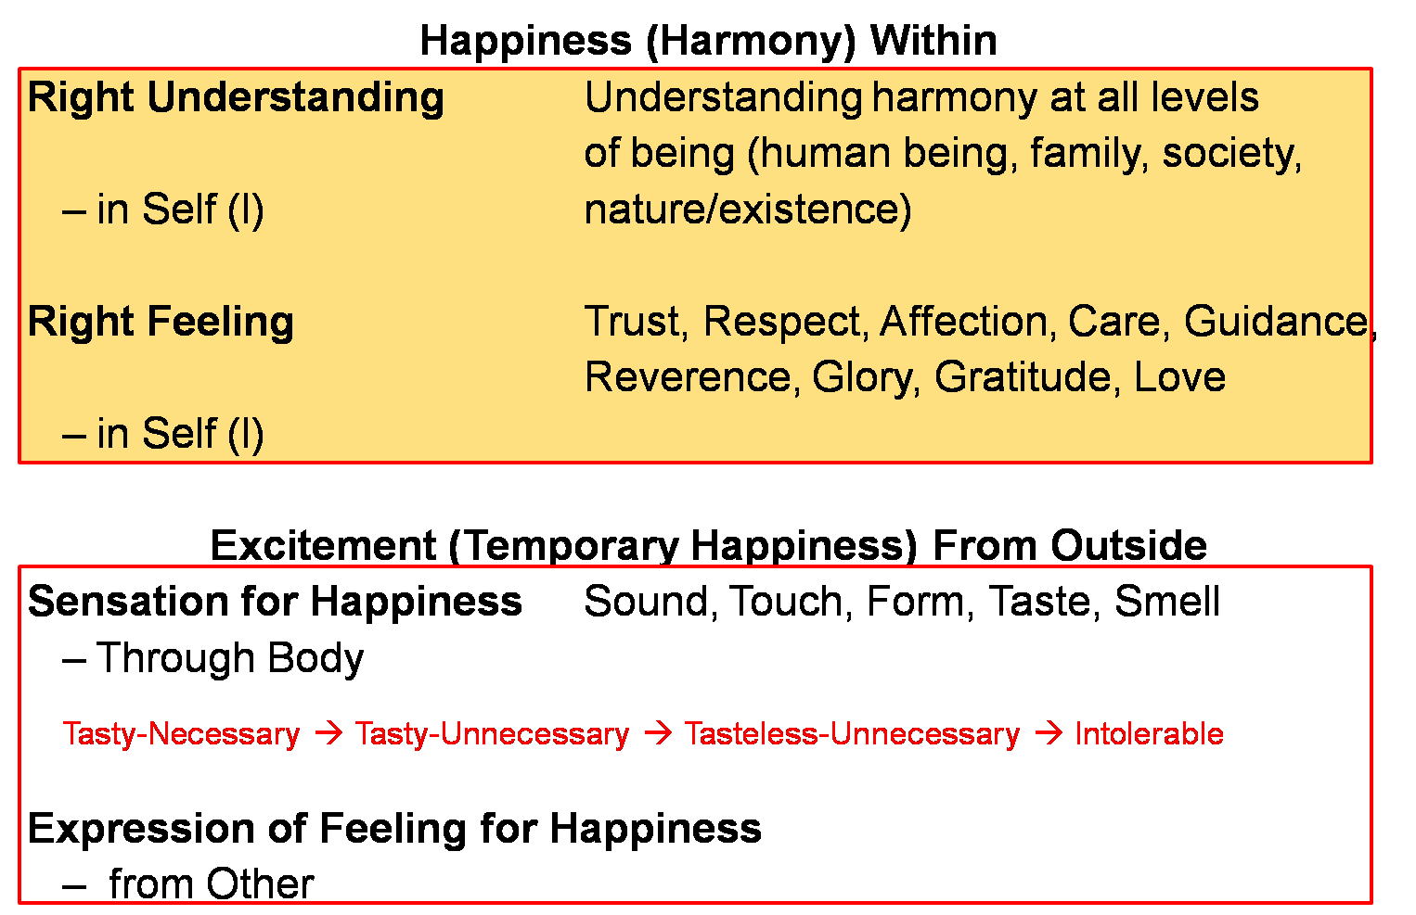

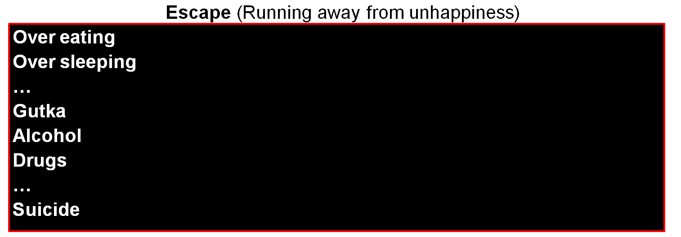
Continuous happiness
Realised
(Dorji)
Human Consciousness
--------------------------------------------------------------------- Transformation / Development -----------------------------------------
Temporary excitement
Recovering
Addict
Animal Consciousness
Temporary escape from unhappiness
Addict

Slide 73
Question(s): Harmony in the Self, Happiness Response
I can see that I can work within. But what about outside, with others. I have a desire to work also and to be with the family also. I want to fulfill both and feel that if any of those is not fulfilled, I will be unhappy. What is the way forward?
We have to understand the harmony in society and harmony in family & nature and then define a way of life, a system in the society, which ensures the fulfilment of all these harmony. Then we will be free of these contradictions.

Slide 74
Extra Qs.
6th sense
Intuition
Reflex action
Intellect
Cognitive ability
5 quotients
SQ Social quotient self+body+…
IQ Intelligence quotient self
EQ Emotional quotient self
SQ Spiritual quotient self
Split personality
Schizophrenia

Slide 75
Can you comment about Freud’s theory of motivation

